Slide 1
MOMBOT
Aditi Mittal (00901032015)
Nishtha Malhotra (03801032015)
Ayushi Mehndiratta (04101032015)
Dakshyani Singh (04301032015)
Vipasha (04401032015)
Ishita Rathi (04801032015)

Slide 2
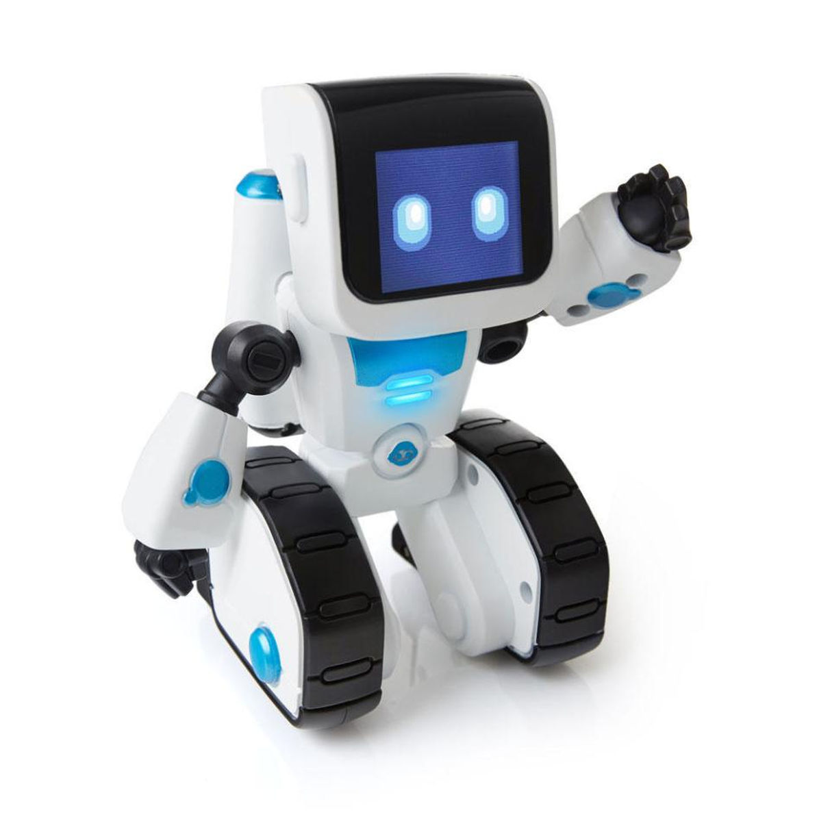
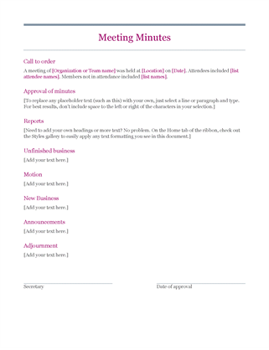
Problem Statement
To create an in-meeting virtual AI assistant which can create the Minutes-of-meeting automatically
+
=

Slide 3
Data Source
AMI Corpus (http://groups.inf.ed.ac.uk/ami/download/)
Corpus consists of about 100 hours of recorded and annotated meetings
There are two types of meeting: scenario and non-scenario meetings.
In the scenario meetings, groups of four participants take part in a series of four meetings and play roles within a fictitious company. While the scenario given to them is artificial, the speech and the actions are completely spontaneous and natural. There are 96 meetings in the training set, 24 in the development set, and 20 meetings for the test set.

Slide 4
Annotation
Annotators wrote abstract summaries of each meeting and extracted transcript dialogue act segments (DAs) that best conveyed or supported the information in the abstracts

Slide 5
PreProcessing
Transcript was saved using Nite XML Toolkit(NXT)
PDF was converted to doc
[vocalsound] and [disfmarker] were removed from the file
Speaker diarization was removed

Slide 6
ATTRIBUTES
Audio file
Transcript(XML and txt)
Extractive summary
Minutes of Meeting

Slide 7
WORK FLOW

Slide 8
Add members by the link
Speech to text
Intermediate summarised document
Mail the MoM to the members

Slide 9
Used text rank algorithm(similar to page rank)
(ref: https://web.eecs.umich.edu/~mihalcea/papers/mihalcea.emnlp04.pdf)
Used Google Speech Recognition API for speech to text and audio to text
For comparing the result, used SequenceMatcher from difflib library

Slide 10
EVALUATION & RESULTS

Slide 11
Performance metrics
Judged the performance of assistant based on:
Accuracy of conversion from speech to text
Accuracy to summarize the points accurately and concisely as discussed in the meeting

Slide 12
Accuracy for Speech recognition
From Audio file to text-
Recall-0.239942528736
Precision-0.56228956229
From Speech to text-
Recall-0.341954022989
Precision-0.817869415808

Slide 13
Thank you

